Slide 1


Super advisor : Flavio Corradini External advisor : Marco Piangerelli & Alessandro Bacci
Università di Camerino
Computer Science - Master Degree
Complex System Design Project
In collaboration with :
Titolo Progetto
Alessandro Finocchi : alessandr.finocchi@studenti.unicam.it
Simone Piangerelli: simone.piangerelli@studenti.unicam.it
Lorenzo Federici:
lorenzo.federici@studenti.unicam.it

Slide 2

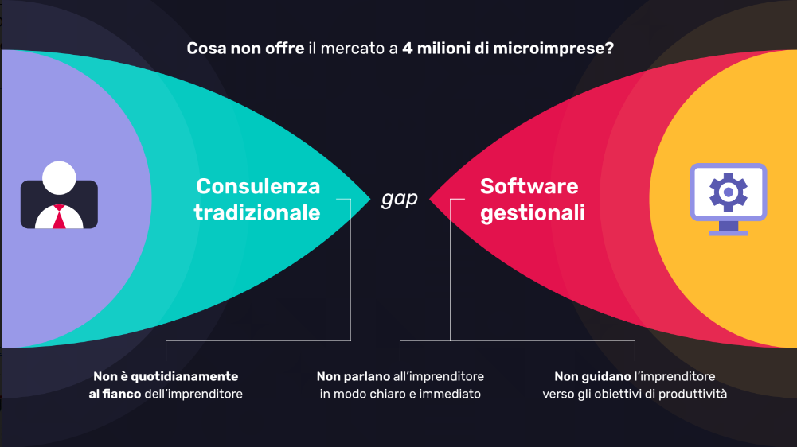
Ciao sono Syeew
Syeew's mission is to disintermediate "business consultancy" services, making decision making on operational decisions with a direct impact on the income statement of micro-enterprises easier, more aware and timely.

Slide 3
Introduction:
Currently, micro-enterprises cannot have advanced digital tools due to barriers in terms of costs, time and culture, through:
A neural network, characterized by proprietary performance algorithms (patent application June 2021), which led to the creation of only four Business Emoji to capture and represent "in the blink of an eye" the trends of the business in its components badges;
The AI ​​engine that takes the place of a real "consultant always in your pocket", proposing in natural language explanations on the current situation and, through the proprietary model, providing suggestions on actions to be taken to improve performance.

